Slide 1

Advanced Early Dengue Prediction and Exploration Service
Dominic Ligot, Claire Tayco, , Jansen Lopez, Mark Toledo
October 2019

Slide 2



Our Challenge

Slide 3
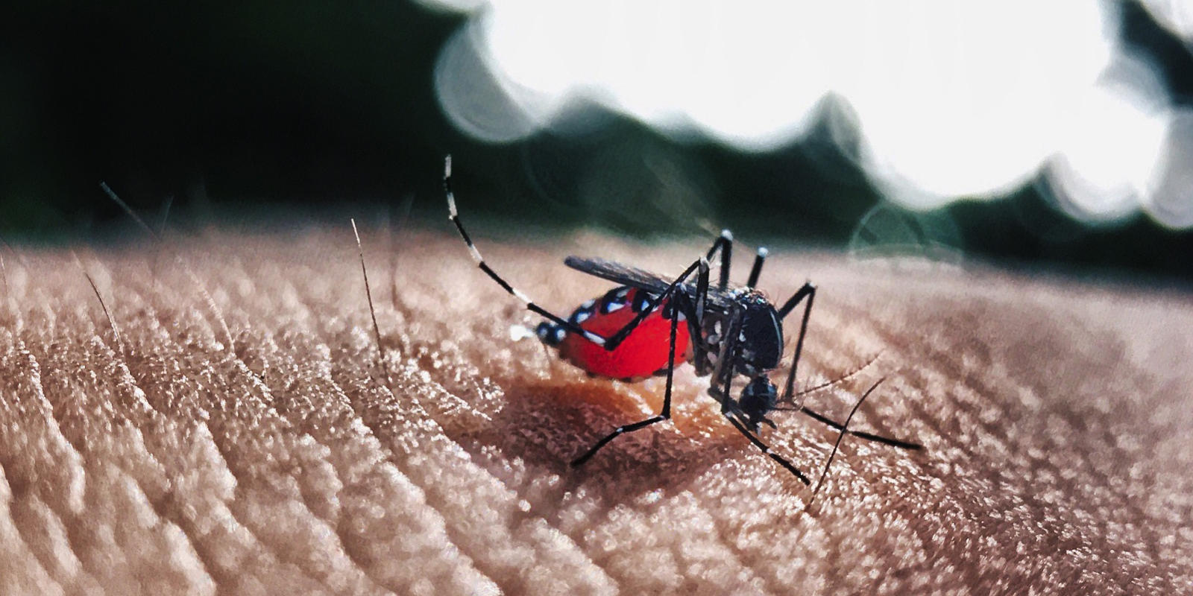
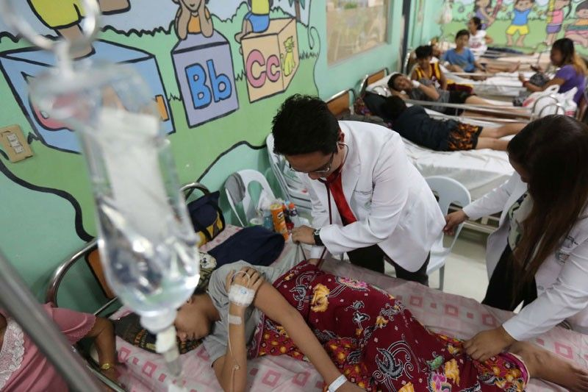
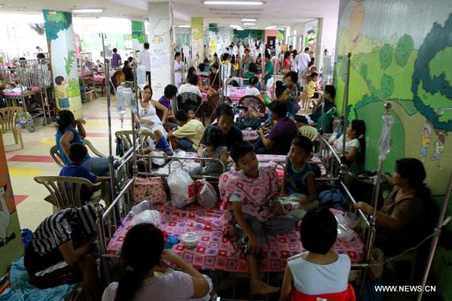
The Problem: Philippines Dengue Epidemic
1,107
271,000+
Deaths
Cases
Source: Department of Health

Slide 4
The Problem: Philippines Dengue Epidemic
1,107
271,000+
Deaths
Cases
Reporting is manual and dengue data is delayed.
Public Health Sector’s resources are limited.
We need to move the emphasis from treatment to prevention.
Source: Department of Health

Slide 5
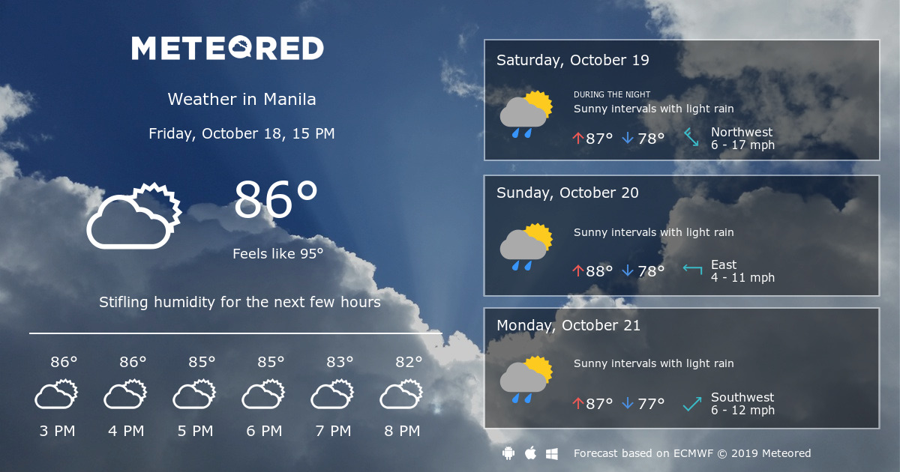

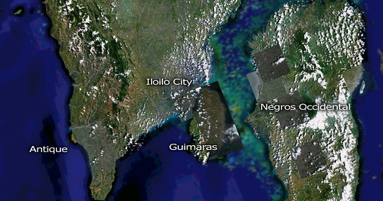
Solution: Advanced Dengue Prediction
Correlate dengue cases and deaths with real-time data from climate, google searches, and satellite maps, giving an advance indicator of when dengue will emerge and potential dengue hotspot locations.

Slide 6


Capturing The Dengue Data Cycle
Data
Data
Data
Climate
Creates mosquito breeding environments
Mosquitoes
Get infected and spread cases of disease
Searches
Triggered by public alarm and spread of cases and deaths
Deaths
Occur if cases are untreated
Reports
Cases and deaths are reported to Department of Health (2-3 months lag)

Slide 7
Searches for Dengue: Epidemic of Panic
Source: Google Searches (% Growth, January 2017 = 1)

Slide 8
Correlating: Dengue Cases and Deaths
Training Period
R2 = 85%
Testing Period
R2 = 69%

Slide 9
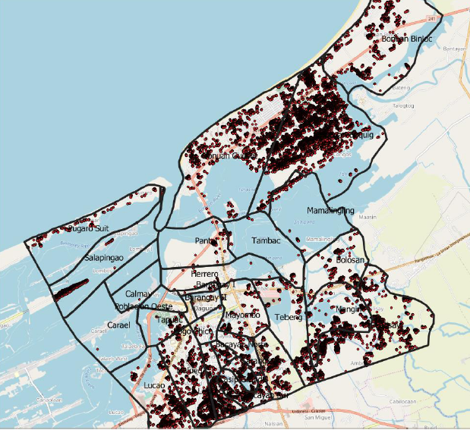
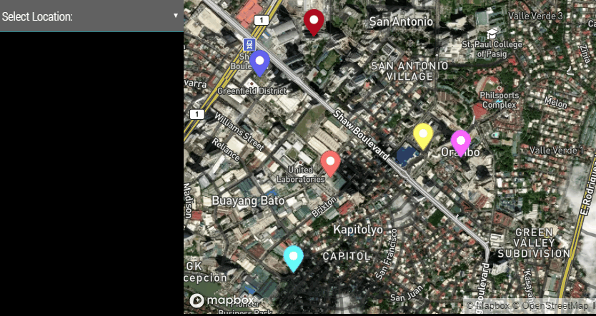
Finding Mosquito Hotpots From Satellite Images

Slide 10
AEDES Dashboard

Slide 11
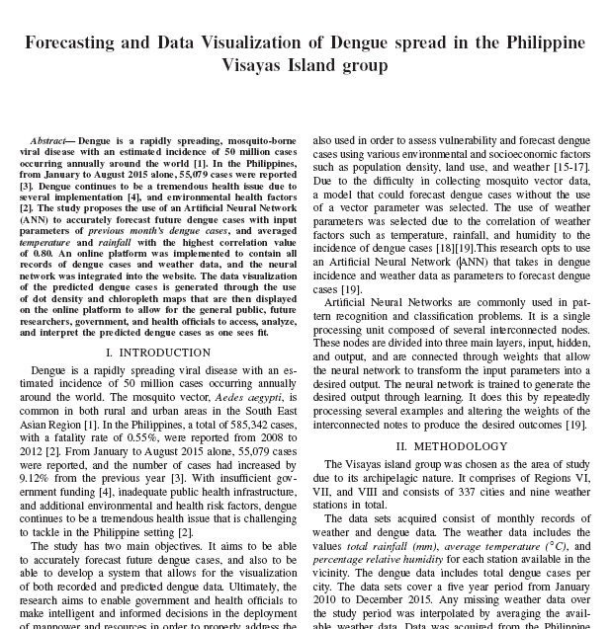
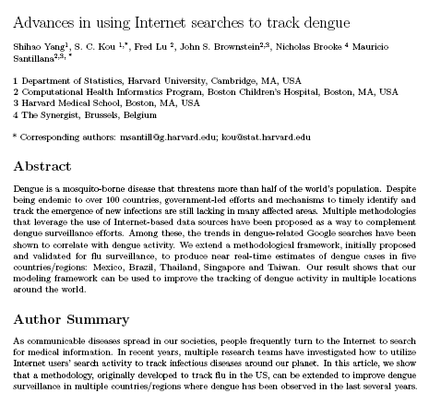
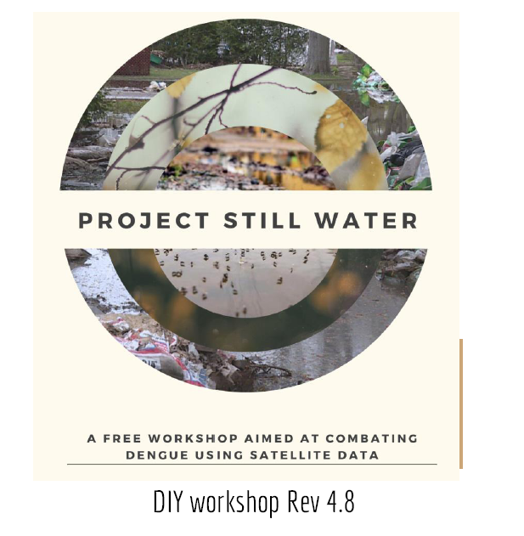
Related Literature
Caro, et. al. 2016
Yang, et. al. 2016
Chua et. al. 2018

Slide 12
Our Impact
For every single day we can reduce the lag in response time we save:
5
1,130
Lives
New Cases

Slide 13
Next Steps
Complete time-series training for all regions
Add satellite data for all target regions
Recommend target areas for on the ground dengue case and deaths monitoring
Set future thresholds for dengue epidemics and short list areas that will be hit first

Slide 14




Team AEDES
Dominic Ligot Project Lead
Claire Tayco Statistical Models
Jansen Lopez Geospatial Models
Mark Toledo Software Engineer

Slide 15
Save Data. Save Lives.
aedesproject.org

